Slide 1
Telecom ISU Overview
April 2011

Slide 2
TCS Corporate Overview
Introduction
Business Domains
TCS was established in 1968
FY 2011 revenue of USD 8.2 billion (up from USD 6.3 billion in FY 2010)
Over 1,98,614 employees
1st Company in the world to be assessed at Level 5 for integrated enterprise-wide CMMI and PCMM
Global Presence - 142 offices in 42 countries
First and Largest
Software R&D centre in India
Software exporter in India
FY 2001-11 - % revenues

Slide 3
Telecom Overview
Highlights
TCS Telecom Footprint
Leading Global IT service provider for Telco’s
13700+ consultants for global Telecom engagements
Right partner for customer experience & Innovation
Technology Labs & CoE’s
Multi-technology component support
Proprietary frameworks to enable best-in-breed process operations
Dominant player in telecom software services
5 of top 10 Communication service providers worldwide
4 of top 6 European Telco’s
World’s Leading Cable and ISP providers
5 of top 7 North American Communication service providers
4 of top 5 Communication equipment vendors
Leading Indian telecom service providers
Telecom Revenues FY 2010 - 11
$ 990 Million
{12.1% of TCS Total Revenues}

Slide 4
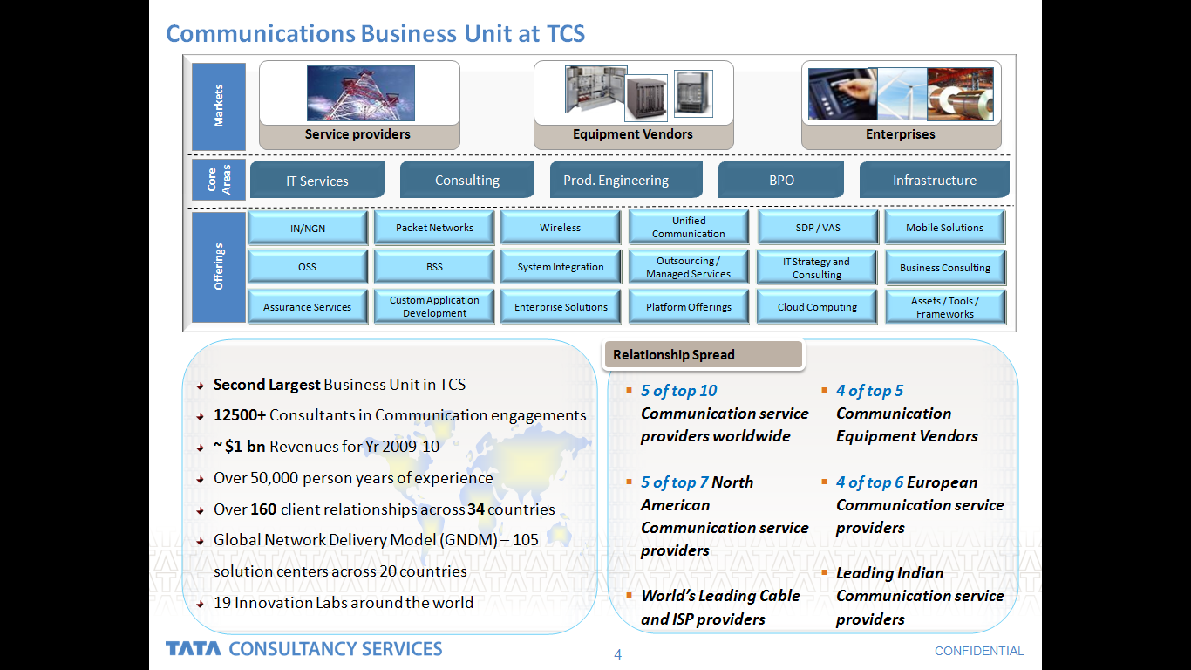
Telecom Overview - Markets and Offerings
Markets & Customer Focus
Value add
New products/services
Customer experience
Profit Margins
Quality of Service
Anytime, anywhere
Flexible Tariff plans

Slide 5
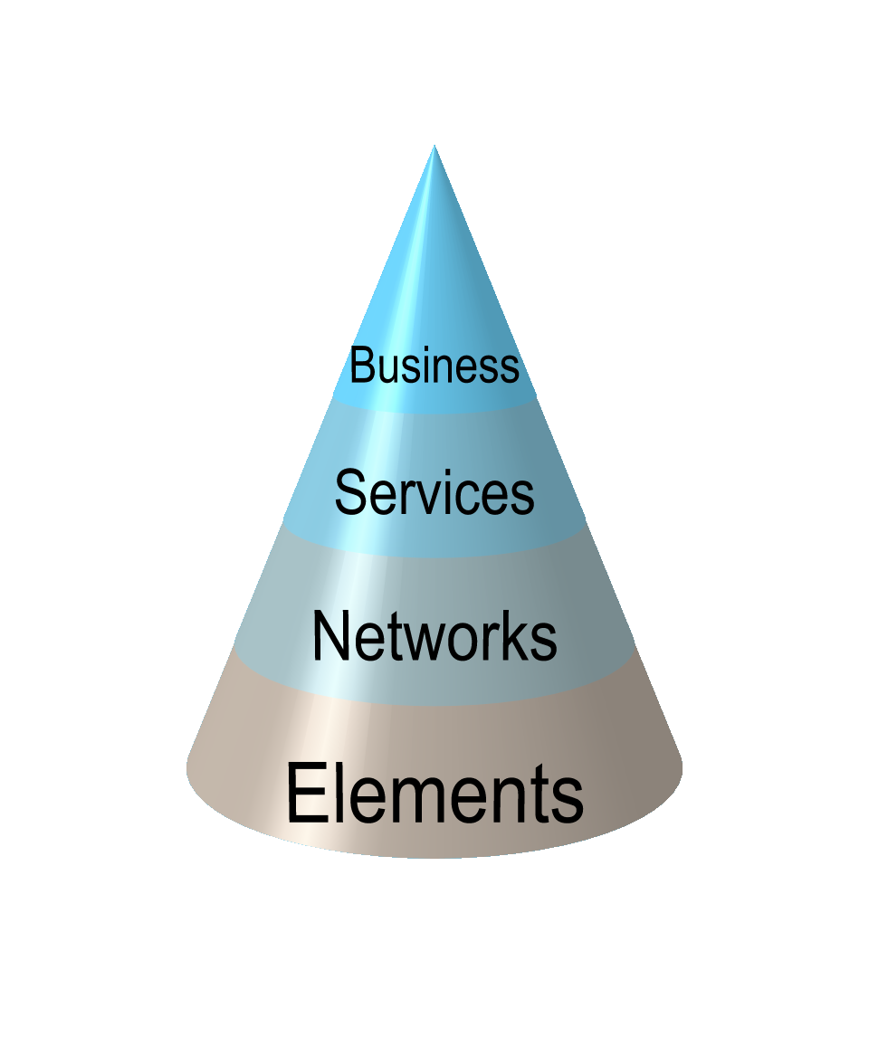
Telecom Services Spread
Finance and Controlling
Materials Management (e-Procurement)
Supplier/Partner Management
Enterprise Management
Customer Relationship Management
OSS/BSS
Order Management
Service Provisioning
Customer Care
Fault & Workforce Management
Billing (Retail/Wholesale/Inter-carrier)
Telecom Service Providers
End-to-End Offerings
IP Transformation & IMS
Network Engineering (Wireless & Packet Networks)
Convergence Applications
Network Management Systems, Network Inventory Systems, Mediation Systems
Telecom Equipment Manufacturers
Networks
Intelligent Networks
Product Engineering for NGN Elements
UMTS, 1xEVDV and Other Specialized Protocols and Stacks
Element Management Systems

Slide 6
OSS/BSS - Spread of Offerings
Billing
Systems Mgmt
Maintainance
& Enhancement
Performance
Management
Arch Definiton
Sys Integration
Upgrade &
Migration
Implementation
ADM
Operations
Systems
OSS/BSS
Processes
Define, Design, Develop,
Implement, Support/Operate the
best Solution using models such
as βco, BIFT, ROBossT
Driving Operational Efficiency , Optimizing
Costs and Increasing Throughput by leveraging Quality Process Control Methods (CMMi, PCMMi and Six Sigma)
Process &
Interface specs
Process Maps
& Models
Optimization
Defining Process Specifications
and Models using industry
standards -eTOM, NGOSS

Slide 7
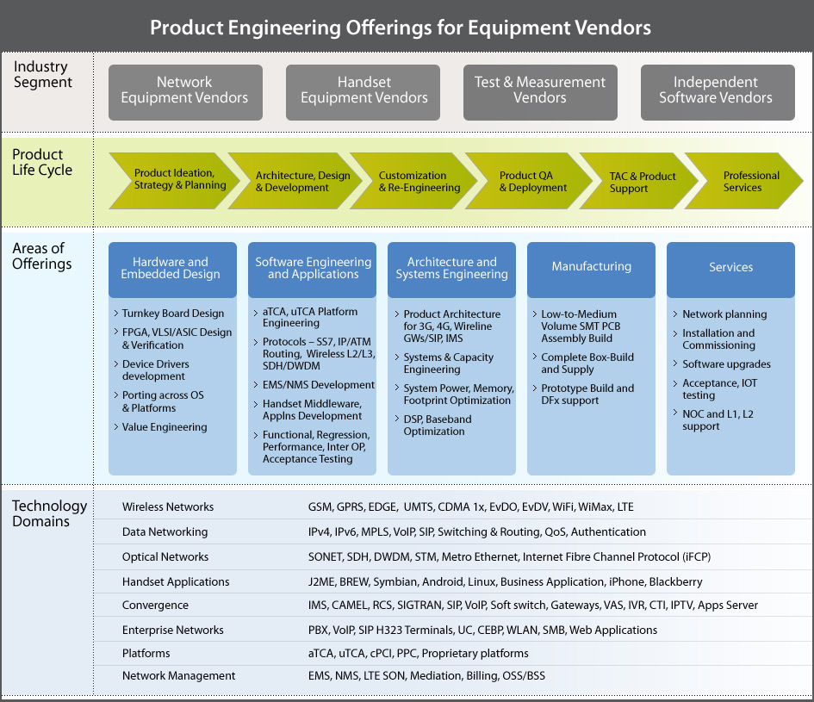
Product Engineering offering for EV’s

Slide 8
TCS Value Add - Addressing Operation Issues
Inaccurate billing and pass through surcharges
Poor bill cycle controls
Lower Total Cost of IT Operation across all domains of the TELCO world
Outstanding customer debt and disputes
Irreconcilable differences between billing and financial systems
Poor credit and collections processes
Inaccurate rating and discounting
Excessive rate table management costs
Excessive levels of transactions in suspense
Billing
Rating
Finance
Unprofitable products
Customer profitability
Incorrect prices, plans and promotions sold to customers
Inability to reconcile discrepancies between network facilities and network inventories on a timely basis
Inability to capture CDRs completely and accurately
Digitization of network maps
Network
IT Services
Revenue Assurance
Sales &
Mktg
Interconnection agreement management
Supplier performance monitoring
Using expired contract rates for enterprise and wholesale customers
Inaccurate management of volume discounts
Telecom
Services
Network Cost Management
Tools
Methodology
Mediation
Contract
Mgmt
Excessive levels of transactions in suspense
High levels of rejects and errors
Inaccurate error detection, filtering, reformatting and distribution of records to the downstream
Customer
care
Order
Mgmt
Excessive backlog of orders
Discrepancies between what is ordered, provisioned, and billed
Provisio
ning
Incorrect use of credits, adjustment and discounts
Inadequate IT Services performance
High customer churn
Excessive backlog of orders
Discrepancies between what is ordered, provisioned, and billed
Focus on Revenue Increase, Revenue Assurance and Reduction In Customer Churn

Slide 9
Our End-to-End Capability for ‘Backing Growth’
Process Consulting
Implementation of New OSS Stack
Re-architecting OSS Stack
Support Business & Application Consolidation - Acquisition
Lean Operations - Continuous Improvements
Standards & Framework: TMN, NGOSS, OSS/J etc.
Pre Paid Post Paid Convergence
Triple Play Readiness
Service Creation Layer
WLAN-WWAN Handoff
Customer Experience Lab
NGOSS MDA
eTOM based Business Process
BEAT Architecture Framework
BIFT Framework
Common Information Model
Data Migration
Solution Accelerators
Revenue Assurance
Lab as an enabler
Alliances With Major product players
Strategic partnerships

Slide 10
TCS NGN Capabilities
Network Transformation
Network Integration Testing
Core Network Plan/Design, Architecture
Network Assurance
Test Case Factory
Inventory and Configuration Management
Test Management Tools
Test Execution Equipment
1
3
NGN
2
4
Solution Design & Vendor Evaluation
Services Design, Development & Deployment
System Integration & Product Assurance
Consulting for transforming & consolidating multiple processes
Defining new optimized architecture
Migration of applications
NGN Services
Platform & Services Consolidation

Slide 11

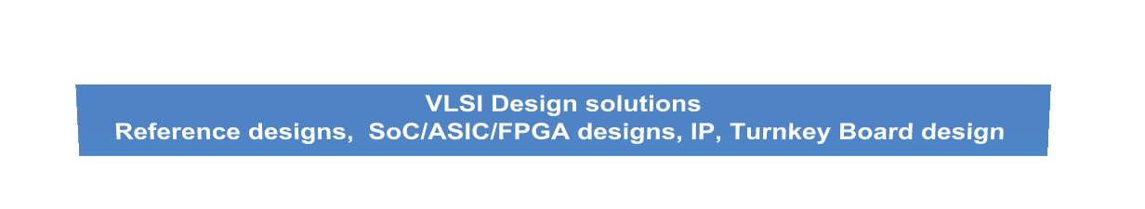
Device based Offerings
Embedded Systems Solutions
Telecom R&D and Product Design
Mobile Handset
Solutions
Telecom Testing Solutions
Device Drivers development,
Porting across various embedded OS & Processors
Middleware components development
Multimedia and DSP Development & Optimization
Systems Design and Development
Telecom R&D
Application Development
Voice Switching
Wireless Networks
Optical and Broadband Data networking
Testing Equipment Manufacturers
Applications development
Integration and Testing of Mobile Platform
Development
Device Drivers Development and Kernel Porting
Porting across various Device Operating Systems and Processors
Conformance & Functionality Testing -component & application level
Interoperability & Regression Testing
Test Strategy & Planning and Test Automation
Performance Testing – Stress Testing
White Box Testing - Code Coverage
Protocol Testing and Interface testing

Slide 12
Mobile VAS Offerings
10 years of mobile experience
Focus Industries, For initial VAS Solutions
Telecom, Banking, Financial Services, Insurance, Retail & Consumer Goods, Media & Entertainment
20+ Telecom operator Relationships
Enterprises
Managed Mobile Services
Software
Engineering
Concept to Completion capability
Mobile-VAS assets developed
Process Framework
Provide our Telecom Operator customers with a secure Platform, Telco grade and a host of VAS solutions for them to Pick and choose offerings
Use the same to provide our enterprise customers value
Mobile
Financial
Services
Telecom Operators
Telecom VAS Platform
Mobile
Testing
Working with large E&V Operators in the Mobile space
Incubation Labs working on rolling out assets with other ISU’s
Mobile
Portals
Voice
Channels
VAS Solution companies
Geography Support
Mobile
Media
Extending the Enterprise
Service
Delivery
Platforms
Telecom Content aggregators
In-house productivity enhancement
Top management commitment
Also Build VAS solutions around
Energy & Utilities, Manufacturing, Travel & Hospitality, Government, Life-Sciences & Healthcare
A couple of operators already proposing a long term relationship

Slide 13
Mobile Transformation Offerings
Mobile Solution Portfolio Analysis & Rationalization
Mobile Business Case
How do I improve my mobile ecosystem?
Can mobile technology add value to my business?
Mobile Business Case
How do I realize the ROI & benefits?
What are my mobile user’s requirements?
mORG
Optimize
Strategy
mORG
How do I apply various mobile policies?
What devices suit my organization’s needs?
Mobile Infrastructure
mORG
Mobile Business Change Management
How do I manage the business change?
What is the right-fit mobility architecture?
mORG
Mobile Information Security
How do I take care of the risks involved?
What will be the infrastructure needs?
Mobile Infrastructure
Manage
Implement
mORG
How do I govern mobile solutions?
What are the security issues involved?
Mobile Information Security
How do I ensure quality of the solutions? How do I support them?
How do I integrate & implement disparate technologies together?
Quality Conformance &Sustenance
Quality Conformance &Sustenance

Slide 14
IPTV Offerings
Consulting
Network Services
OSS/BSS Services
Network readiness assessment - access
Roadmap for Nw deployment - access
Regulator analysis
System Integration
Content Services
Application Services
Network
Services
Network migration services
STB stack development
STB integration
Testing Services
Content (management) strategies
DRM strategies
Partner strategy
CDN strategy
Middleware strategy
Network testing
STB testing services
Network bottleneck testing
Field trials
Content mgmt process definition
Content mgmt solutions
Scheduling
Promotions
Contract mgmt
License mgmt
DRM
Advertizing
MIS/BI
Archive mgmt
Head end deployment
Middleware app development
Deployment & Maintenance
Content
Services
Network lifecycle management
Content quality testing service
DRM testing
QoE testing
CDN testing
Middleware testing services
BPO
OSS/BSS readiness assessment
OSS/BSS roadmap and RFP development
System rationalization strategy & roadmap
Revenue assurance
Content lifecycle management
CDN enhancement and maintenance
Middleware enhancement
NOC operations
OSS/BSS
Services
Meta data creation and management
Fallout management
Process definition
OSS/BSS integration
Real time FAB & BAM
Infrastructure services
Middleware integration
Tools development
Revenue assurance
OSS/BSS testing suites for IPTV compliance
Test execution
System enhancement and maintenance
Infrastructure services
Jeopardy management
Manual task handling
Service strategy from Concept to cash
Partner strategy
Competitor offering analysis
Service quality testing and analysis for scalability
Service adoption mgmt
Level 1/2 support
Contact centre operations for Sales & Support
Application
Services
SDK for service creation
Service deployment and repository mgmt
Services life cycle management
Infrastructure services

Slide 15
Broadband and Broadcasting Offerings
Conceptualize
Plan
Select
Stage
Implement
Operate
Conceptualise Offerings
Identify Technology Partners
Establish Proof of Concept (POC)
Plan for Content
Plan for Services
Plan for Network
Plan for Technology
Plan for Framework
Plan for Broadcast Head end
Plan for Video Server
Plan for CA/DRM encryption
Customer Premises Equipment (CPE)
Finalise Requirements
Prepare and Release RFP
Evaluate vendors & solutions
Select Vendor and solution
Component Integration
SI
Customise
Build new services
Configure
Security Testing
Limited Field Trials
Simulated Load Tests
Scale the solution
Manage Configuration
Manage Localisation
Manage Network
Manage Location/sites
Support and Maintain
Enhance
Add new services
Upgrade services
Upgrade middleware
Upgrade OSS/BSS system
Stage

Slide 16
Telecom BPO Value Chain
Customer Relationship Management
Service Management
Billing & Revenue Assurance
Network Management
Supplier / Partner Management
Customer Contact Center
Order Management
Problem Management & billing queries
Customer Communication
Customer Win back
Directory assistance
Service Configuration
Service Provisioning
Service Problem Management
Service Quality Management
Bill generation and Invoicing
Collections and posting
Revenue Assurance
Network Planning
Network Provisioning & activation
Network Performance Management
Network Inventory Management
Engg. Workforce Management
Supplier Commercials Management
Supplier Contract Management
Supplier Problem Management
Supplier Communication
Finance & Accounting
Accounts Payable
Accounts Receivable
Employee Expenses Processing
Fixed Assets
General Ledger Accounting
Financial Reporting
HR Services
Payroll Administration
Employee Management
Sourcing and L&D Support
HR Analytics
Supply Chain Management
Sales and Marketing Support
Stakeholder relations and Regulatory Affairs

Slide 17

Enablers - Telecom Labs and COEs
Customer Experience
Services Layer
Innova
M & E Lab
Wireless and Pervasive Tech
SDP/VAS
Voice (IVR) Lab
Application Layer
Network Layer
IPTV
SDP
OSS/BSS
IN
Lab
INCA
Lab
Handset CoE
Application Layer
SoA and SID based middleware and COTS integration layer that can be used as reusable assets in reducing SI time to implement
Participate in industry standards and forums such as OSSJ and Catalyst programs
PoCs to showcase our assets and experience in emerging services/technologies such as IPTV
Reusable assets/frameworks/accelerators/

Slide 18
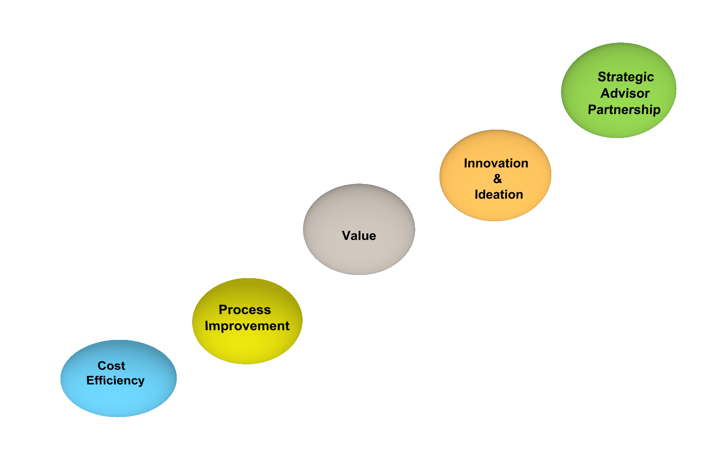
TCS as a Business Transformation Partner
Integrated Services
Global Consulting for IT - Business Align Management, Portfolio & Process management
Infrastructure Services for simplification and servicing
Application Development & Maintenance
Enterprise Solutions
Asset leverage for technology and solutioning
Balanced Score Card
Innovation Lab
New/Existing Solution
Products Transformation
IT Strategy & IT - Business alignment
Shared Services for Enterprise solutions
IS Transformation - On Demand Services, Performance Engineering
New Product Development
Continuous improvements & Process Consulting
Application Development, IS Management & Offshore Leverage

Slide 19

Serving Customers Globally
AT&T
Cricket
Alestra
Qwest Centurylink
Rogers
Sprint
Verizon
XO
Alcatel Lucent
Motorola
Nortel
DNA
Eircom
Hutch Sweden
Hutch UK
KPN (Germany)
Millicom
O₂
TalkTalk
Telefonica Moviles
Telenor Denmark
Telenor Norway
Belgacom
BT
C&W
Ericsson
Nokia Siemens
Racal
Celcom
CTM
Hutch Thailand
NWM TTSL
Tata Sky
Vodafone BSNL
China Unicom
NTL
PLDT
StarHub
MTNL
Tata Communications
Telecom Malaysia
Time Telecom
Telefonica
Columbia
Nextel
TelMex
CellC
Vodacom
MTN
Neotel
DU
OmanTel
Batelco
Saudi Telecom
Wireless Service Providers
Austar
Foxtel
Vodafone Hutch
Wire Line Service Providers
Equipment Vendors
Over 900 Million Subscribers run on Solutions Architected, Managed and Serviced by TCS’ Telecom Vertical

Slide 20























Global Alliances
OSS/BSS
EAI
CRM/ERP
BI/KM
NMS/EMS
IN/NGN
Testing
Network elements/Mediation

Slide 21






Standards Bodies Relationship
Regular participation in ITU-T based conferences such as SDL Forum
Participation in ETSI protocols test specification evolution, T1/RAN Meetings
IEEE forum membership and regular participants in conferences & publicationcs
Development of the SIP Lite specification through participation in JSR 125 group
J A I N
Frameworks (eTOMTM, BETACOTM, tBIDSTM, RoBossTTM, OSS EvolveTM etc)
Regular participation in Storage Area Network Association proceedings
Promote the commercial testing tools and test infrastructure for the communications industry
Regular participation and paper publications in CSI, IETE, CDG, CDMA Congress, TestCom, ACM etc.

Slide 22
Our Offerings in detail

Slide 23



Consulting
Offerings
Assets
IT Strategy
Business Process Management
Fraud Management
Revenue Assurance
Process Auditing
System assessment and fit analysis
RFP/RFQ development
Product/Vendor Evaluation
OSS Life cycle management
eTOM and NGOSS recommendations
IN/NGN evaluation/services
βCO
Pyramid
wASPIRE framework
BIFT
White papers
Best practices
Approach notes
Knowledge repository
Value Addition
Streamlined processes
Reduced time to market
Alignment to business strategy
Better revenue realization
Cost rationalization

Slide 24
Application Development and Maintenance
Offerings
Assets
Products Expertise
IT Strategy
Business Process Management
Fraud Management
Revenue Assurance
Process Auditing
System assessment and fit analysis
RFP/RFQ development
Product/Vendor Evaluation
OSS Life cycle management
eTOM and NGOSS recommendations
IN/NGN evaluation/services
TBEM processes
Best practices
Ready made modules
Custom built adaptors
Process maps
Tools and utilities
Reusable frameworks
AS/400 - Mainframe
Open System/Linux/Unix
Microsoft
Novell
VMS
CSG Kenan/BP, Prepaid
Amdocs Ensemble, Prepaid
LHS, CABS from SEMA
IBM ICMS, Portal Infranet
Savera, Intec
Lucent, Fusion Works, Telcordia
Value Addition
Reduced cost of development
Technology agnostic
Rapid turnaround time
Reduced cost of maintenance through reduced defects
Operational efficiency

Slide 25
CRM/ERP
Offerings
Assets
Products Expertise
Business Activity Monitoring
Data Migration
Service activation
Rule set development
Network and Service entity modeling
OSS Integration
Service impact analysis
Order Processing Solution
Point of Sale
Industry specific Prototypes
Design Patterns
Approach papers
Estimation Templates
Advanced in-house training
Certified Resources (Siebel)
Knowledge transition methodology
SIEBEL
Oracle CRM
SAP
Clarify
Saleslogic
PeopleSoft
Genesys
Salesforce.com
Chordiant
Lucent, Fusion Works, Telcordia
Value Addition
30% cost savings year on year on application maintenance
Forrester group labels TCS as the “Best Overall Value”
Unified CRM system providing a 360 degree view of customer

Slide 26
Order Management/Fulfillment
Offerings
Assets
Products Expertise
End to end solutions
CRM/ERP Implementation & Integration
Selfcare
Order Management
Service Management
Sales Force Automation
Testing and Maintenance
Data Migration
Production Support
Data Cleansing
Trouble Management
Number portability
PLM
FTTx
BPM
Mobile Fulfillment
Inventory Consolidation
InventoryMigration
Activation Adapters ASAP/Comptel
Activation Solution
Process flows
KPIs
Point of Sale
Self Care solution on Netonomy
Product Evaluation Criteria
Requirements gathering questionnaire
CRM – Siebel, Peoplesoft Accelerator
OSM Accelerators
PLM Accelerator – Solution, Analytics, process, I2L Framework
Test scenarios
Activation Integration
APIs
TCS SoFT Framework
SOLAR Framework
Implementation accelerators – POS, Selfcare, Number, SIM. Voucher, Loyalty, Commissions, Dealer, Device, Prepaid CRM
MNP solution Accelerators
Amdocs Cramer, Clarify
Oracle M6, OSM, ASAP
Objectel
Clarity
Kenan FX
PeopleSoft
Oracle
Siebel
Tertio
Comptel SAS, Instalink
Comptec
CEON
Tribold
Syniverse
Value Addition
Highly customized, cost effective solution with short time to market
Integrated one-face OM interface for multiple business lines
Improved service fulfillment and activation response time by over 60%
Improved customer experience

Slide 27
Billing/Mediation
Offerings
Assets
Products Expertise
Billing Transformation: Lean Operations, Billing Migration, Testing, Billing process consulting Architecture Assessment, B2O for Process and Systems Rationalization
Billing Convergence: Prepaid Postpaid Convergence, FMC, E- Stapling, System Integration
NGN Impact On Billing
Billing Self Care and Analytics
NGN Settlement
Dedicated billing product COE
IT Services Implementation Accelerators
Product Evaluation Kit
Telecom Labs & CoE
BPO Toolkit
Data Model for Billing
SOFT
FMC Methodology & process flows
Business Process Flows
PPC Analysis Framework
PPC Process
Business KPIs Definition
Testing Framework Data model
Comverse Kenan
Convergys IRB
Oracle BRM
Intec Singl.eView
Suntec TBMS
Metratech
Comptel
Intec IntermediatE
Openet
Comverse mediation
Intec InterconnecT
Amdocs FBF
Intense
Tallyman
Value Addition
Up to 30% cost savings due to solution accelerators
Improved customer satisfaction through a value added single billing solution
Pre built COTS Billing CRM Integrations Collaborative SI, ISV solutioning
Pre-defined best practice billing business processes
Robust Onsite-Offshore Delivery ensuring cost-effectiveness and rapid project execution
Experience of leading successful multi-vendor engagement
Strong Business Domain Knowledge

Slide 28
Revenue Assurance
Offerings
Assets
Products Expertise
Unique Approach of RA: Detect->Probe->Correct->Protect
Revenue assurance consulting
Robust Diagnostics Methodology
Victory iRAS: E2E Solution that covers Revenue Leakages
Alliances with different Revenue Assurance products
BPO offerings - Solution based offerings
Managed Services
Solution Implementation & Operations
Diagnostic Kit
RA Offering documents and collaterals.
RA - response to Proposals
POC methodologies
Application demos
Converters(ASN.1, TAP and HLR)
Shell GUI
Rule Engine GUI
Scheduler
Automated Test Case Generator
Generalized reporting tool
Configurable Dashboard
Automated Error Correction Tool
Workflow
Threshold and Alarms
Experience in Connective Revenue Assurance solution.
Exposure to Ectel Revenue Assurance.
Exposure to Subex - Azure Revenue Assurance solution
Value Addition
Improved customer satisfaction
Reduced customer care complaints
Proactive revenue measurement
Improved system reliability/stability
3 fold increase in productivity
Efficient opportunity management
Improved revenue realization
Improved operational efficiency
Improved process Understanding

Slide 29
Fraud Management
Offerings
Assets
Products Expertise
Fraud Management Consulting
Fraud Management Services:
Review & Audit Infrastructure & process to identify operator’s risk/exposure to frauds
Define & support to layout fraud management policies
Fraud Management solution implementation and operations
Evaluation of fraud detection tools/products, configuration support & end-to-end operations
Diagnostic Kit
Fraud Management Framework (Victory integrated Fraud Management System - ViFMS)
Capability to execute PoC and demos for Fraud Management
Experience in Connective Revenue Experience in Neural’s Minotaur Fraud Management System
Exposure to Subex’s Nikira Fraud Management System
Exposure to Ectel’s FraudView Fraud Management System
Value Addition
Reduced risk of exposure to different fraudulent activities
Proactive revenue measurement
Improved revenue realization
Reduced customer care complaints.
Improved customer satisfaction
Improved processes efficiency to detect Fraud

Slide 30
Service Assurance
Offerings
Assets
Products Expertise
TCS Way of Telecom Assurance
Network Management ( Fault and Performance Management)
Service Quality Management (Service Performance and SLA Management)
200+ consultants,1000+ PY’s
Managed Object Framework (MOF)"
BSM Solution
Service Assurance - Assessment model
NetSmart Fault Management Module
Business Case for CPE management using hosted NMS
Service Assurance - eTOM/ITIL transactions
Service Assurance – Operational Metrics
Transition Toolkit
IBM Netcool
IBM Proviso
IBM Metrica
IBM TBSM
IBM SQM
HP - OV TeMIP, OV NNM, SQM
OSI NetXpert
Clarity OSS
TTI OSS
EMC Smarts
BMC Remedy
MyCOM NIMS Pr-Optima
RADCOM
Cramer
Value Addition
Onsite-offshore model
Proactive fault identification and resolution
Short transition times, 6 weeks compared to the industry average 14 wEEks
Service Assurance CoE
90% reduction in outage time
Competency building
Dynamic scalability in manpower
Reduced dependence on vendors
65% faster time to market

Slide 31
VAS,SDP & Enterprise Mobility
Offerings
Assets
Products Expertise
Service Delivery Platform/Content Delivery Platform
Broadband Services
Bluetooth/ Symbian base solutions
J2ME, BREW
Seamless hands-off
Applications using WAP, SMS,
MMS technologies
M-commerce and LBS applications
IPTV
Enterprise VAS
BEA SDP Integration
Open Source SDP Integration and Deployment
Content Delivery Platform
Single Sign On
Convergent portal
M-commerce
Open Source SDP Integration and Deployment
Content Delivery Platform
Single Sign On
Convergent portal
M-commerce
PIM2R
Bea
Oracle
Microsoft
Artilium
Telenity
jNetX
Value Addition
Value Added Applications
Growth in ARPU and revenue maximization
Fast Introduction of Value added services
Enterprise Mobile Enablement
Customer attractive applications
Self Service applications reducing cost for operators

Slide 32
IN/NGN & IP/Broadband
Offerings
Assets
Products Expertise
IMS
Intelligent Networks
Field Testing
Deployment
RF planning
Network Audits
System integration
Tier-2/3 Support
Migration/porting
Calendar Application (Smart Roam)
Van-IP framework
Call forwarding application
Local Number portability
Prepaid Mediation Node
JnetX
Verisign
Telcordia
Alcatel
Value Addition
Flexible ramp up/down of resources
24X7 support
Migration with minimal downtime
Lower cost and high quality of product development

Slide 33
R&D
Offerings
Assets
Product evaluation
Integration simulation
eTOM and NGOSS compliant models
Next generation networks
Simulating new business models
IPR’s for EV’s and SP’s
Wireless data services
NGOSS CoE
Innova Lab
OSS Lab
Network Technology Lab
INCA Lab
Mobile computing lab
Implementation accelerators
Tools and utilities
NetSmart
Enterprise SMS gateway
Bluetooth solutions
Handoff solutions
Value Addition
Faster time to market
In-house simulation leading to reduced cost of implementation
Improved reliability during deployment
Cutting edge technology
Improved revenue realization with more efficient services & networks
Product differentiation through innovation

Slide 34
System Integration
Offerings
Assets
Products Expertise
OSS Re-Engineer
OSS Engineer
OSS Migrate
OSS Deploy
OSS Consult
Frameworks – BEAT, BETACO , SOFT, SOLAR, tBIDS, TIME. cFOCUS, SOBET, VIBE, IICM
Best practices
Case studies
Documentation Templates - Process to Implementation, KPIs and SLA, Strategy documentation and Product Evaluation Criteria
Starter Kit – Plan and To do List
White space Solutions - ASAP carrtidges, Web Self Care , eBPP solution, Number & SIM Mgmt ICOMS, ePOS, Voucher Mgmt, Prepaid CRM
Integration -Bea webMethods IBM, TIBCO, VITRIA, Fusion SilyerStream
Billing - Kenan/BP,Infinys Oracle BRM, Intec
CRM - Siebel, SAP, Oracle CRM, Clarify, Chordiant, Saleslogic, Salesforce.com
ERP - SAP, Oracle Apps
Order to Provision - ASAP, M6, OSM, Comptel, Intec
NMS/EMS- Alcatel, EVIOAN,HP, IBM MICROMUSE Agilent
Vallent,CA
Value Addition
Single point, scalable solution provided with high quality
Lowered risks owing to large program experience, product knowledge and a tested deployable solution framework,
Fast time to market leveraging assets and implementation accelerators like ready non core customization packs for products
Short ROI term, migrated to production in 15 months
Packaged Solution Cost Model , which includes the implementation, training and documents.
Supporting Labs enable POC and also test the solutions accelerators in a COTS environment

Slide 35
Infrastructure Services
Offerings
Assets
Products Expertise
Infrastructure management
Offshore monitoring and management
Application Support
Operations Maintenance
Platform Migration
Managed services
Application packaging
Global helpdesk
ROBossT
OSS Enhance
Infrastructure CoE
Six Sigma
BS 7799 compliant processes
ITIL processes
Training programs
Knowledge repository
TMM
HP Openview
Remedy
Unicenter
Tivoli
Cisco
Avaya
NICE
Davox
Mainframe
NT
Novell
Unix
Value Addition
Lower Total cost of ownership through highly efficient processes
Faster response times owing to streamlined workflows
Low error rates by leveraging best practices and assets
Continuous productivity improvement year on year
Focus on core business
Reduced downtimes through higher availability of systems
Reduced risk through secure solutions

Slide 36
Business Process Outsourcing
Offerings
Assets
Products Expertise
Design Services
Billing Operations
Data Management
Design and Provisioning
Data Analysis
Customer Contact Care
Back office Operations
24x7 customer support
Managed Services
Revenue Assurance
Services in 10+ languages
Victory iRAS
Best practices
Template
Methodology
ITIL
BS 7799
SAP
Oracle Apps
Value Addition
Improve performance by consolidation & reengineering processes
Effectively manage costs through best practices
Reduced response time
Reduced risks owing to secure transactions

Slide 37
BIPM
Offerings
Assets
Products Expertise
TCS offerings under BIDS umbrella
BICC
BIBP
M2X
BIDD
U2X etc
Telecom BI Solution frameworks for
Network QoS- Customer experience
Campaign management
Social Media analytics
Churn Management
tBIDS solutions consisting of
Data model
Industry standard KPIs
Analytical Templates
Point solutions of churn management, GIS based BI & Customer lifetime value
KPI map to eTOM, tBIDS entities and dimension/measure identification
eVBIDS solution with data model for eV Business
BIDS templates
BI products supporting
Integration
Reporting
Analytics
Data storage
Product vendors including Oracle, SAP, SAS, IBM, Microstrategy, Informatica, Teradata etc
Value Addition
Assets help in reducing the overall cycle time for design in BI projects
Comprehensiveness of the offerings and TCS expertise in service rendering helps providing a cutting edge to the customer

Slide 38
Hosted OSS/BSS
Offerings
Assets
Products Expertise
Own, host and manage OSS-BSS (COTS) applications for Telco’s
Comprehensive TCS Enterprise Application suite (Enterprises)
Process based consulting leveraging the massive TCS telecom experience.
Back-office operations(BPO)
Implementation accelerators - Transactions/ Process Maps, KPIs
Prebuilt components – Frameworks, whitespace solutions
Oracle
Convergys
Amdocs
Value Addition
Enabling quicker time-to-market, faster gain of competitive edge, and better focus on business
Scalable, supporting progressive stack enrichment
Flexible and low TCO
Higher Value to customers
Move towards build once, deploy many

Slide 39
Customer Experience Management (CEM)
Offerings
Assets
CEM consulting framework comprehensively measures customer experience against a host of touch points, to generate a Customer Experience Index (CEI), which indicates CSP’s customers’ satisfaction levels. This data helps CSP’s target and market effectively and accurately.
Core DM offerings: Configuration and activation, Applications and patch management, Trouble shooting and support, SIM and data management, Quality of Services management
Augmented offerings : Hosted , SI, Device Verifications, Device Services, Problem Support and Resolution, Revenue Enhancing Analytics Addition
Prebuilt components – Customer Experience Measurement framework (TEEM™ )
Value Addition
Helps in enhancing customer experience levels
Increased customer loyalty and higher profitability
Influence the factors of consumer behaviors
Helps in measuring the effectiveness of investments
Reduced customer support expenses
Expansion of customer base

Slide 40
Case Study End-to-End Business Transformation for TTSL

Slide 41
TTSL - Transformation Journey
Established
Player
85 million
20 million
Mobile Services
Focus Area
Extensive rampup
New age services
Customer retention
3 million
70 Million Subscribers
Wireline
Standard wireline,
Centrex, ISDN, DID
Leased Line
Wireless (CDMA based)
Fixed Wireless
Mobile
Value Added Services
Voice Mail, SMS
CUG
Data - Games, Web, Ring Tones, downloads etc
STD, ISD, Roaming
Conferencing, Call Hunting
PTB, Prepaid, Postpaid
Acquisition
& CDMA Services
Focus Area
Scalability
Systems Rationalization
Reduced TCO
Inception
Basic Telephony
< 1 million
Focus Area
Minimalist consolidation
Leverage existing stack
Focus Area
Process definition
OSS/BSS Stack
1998
2002
2004
2007
2011
TTSL - India’s fastest growing wireless service provider

Slide 42
TTSL - Strategic Outsourcing - E2E Scope
Strategy & Planning
Program Management
IT Budget & Control
Highlights
TCS responsible for
All aspects of TTSL IT
New IT architecture Implementation
Transfer of IT infrastructure and transition of IT team from TTSL to TCS
Solutions, Service delivery & Operations and Infrastructure Management under stringent operational SLAs
IT service management
Benchmarking of Service Delivery - Systems and Operations
Vendor Management
Application Support
IT Infrastructure Support
Development
Production
Support
Datacenter
Network
Helpdesk
OSS/BSS
POS
CRM
Order Management
Post Paid Billing
Inter-carrier Billing
BPM and EAI
Provisioning & Mediation
Number Management
Inventory
ERP, SCM
Commissions
Directory Enquiry
Payments & Collections
BI
Fraud and RAS
Pre-Paid Billing
Document Management
EBPP, Self Care
Datacenter Operations
LAN/WAN Monitoring/ Maintenance
Desktop Support
Hardware
Servers/ Storages
N/W Routers, Hubs ..Infrastructure
Software
Application S/W Licenses
Network related S/W Licenses
NSS
NMS
GIS
Pre-Paid - Postpaid Convergence
Disaster Recovery
Security
Real Estate
Notes:
This is a complete end to end IT outsourcing engagement where TCS manages complete software, hardware & IT services like operations, facilities management, change mgmt, Application development and so on including program management and planning. TTSL would only have a CIO and a very small core team to manage the outsourced partner.

Slide 43
SLA based Operations Support
IT Service to TTSL is completely SLA based
Over 50 comprehensive SLAs defined and agreed with business for the boundaries & targets
Operations Dash board in place to measure and track these SLAs - Complete Transparency
Business Process Related SLAs
IT Infrastructure Related SLAs
IT Delivery Related SLAs
Activation (for all products
across various scenarios)
x% completion within y1mins
100% completion in y2 mins/hours
Billing
Billing timeliness
Billing completeness
Billing accuracy
Collection
Reflection of Payments across systems
Timelines for Barring/Suspension
Timelines for restoring service
Response times of front-end IT Applications for key transactions
Availability of IT applications
Systems Down time mgmt.
Scalability
Enhancements
Change management
Problem response & resolution timelines
New Application Rollouts
Schedules and Slippages
Defect Prevention
High Operations Efficiency
Enhance Productivity
Faster Time-to-Market
CMMi Level 5 Maturity
Six-Sigma for Billing Operations
Implementation of TL9000
Regular benchmarking
Notes:
TCS Service to TTSL is based completely on SLA. A comprehensive list of SLAs were identified and agreed upon with business units. This document is signed off by TTSL business and TCSL IT teams. However, the SLA are based on current statistics and current TTSL business needs and it is mutually agreed that these shall be revisited every 3 months.

Slide 44
Case Study NGN Transformation - For a large UK based Convergent Service Provider

Slide 45
Relationship History
In over a decade’s relationship with UK Operator from being an IT supplier to becoming a strategic partner, TCS has actively participated in shaping and realizing client’s business objective of enhanced customer experience.
Architecture Transformation
Managed IT Operations & SLA management
Business Results Delivery
Sub-contract
Professional
Services
Setup ODC
Develop Apps
TCS staff rampup
into solution design
& Delivery mgmt
Own Applications
Evolve as
Strategic Partner,
Consultancy
Delivery of complex
Programmes, End to
End Program &
Delivery Management
1994
1996
1998
2000
2002-2005
2006-2007
Aligning with UK operator drivers
Generate More Revenues through new products/services
Improve Operational Efficiency
Enhance Customer Experience
Platform Presence
LOB Presence
Strategic Initiatives
TCS is constantly aligning itself with the evolving Initiatives of our client

Slide 46
Transformation
Text
Business Process
Simplified process measurements
First time right, Cycle Time
C2M, L2C, T2R
Process Definition
(Openreach)
Optimization
Assessment (Optimus)
Text
Service Delivery Platform
Service Delivery Platform
Expose services to partners and consumers
Service Creation Factory (creation of reusable services)
Access Layers
OSS/BSS
Platform based Architecture
Rationalize 3000 systems to 100 systems
Systems Rationalization
Capabilities based Matrix Architecture
Systems Rationalization
Regulatory Compliance/ WLR3
Network
Migrate 30M voice customers over 4 years
1B£ savings per year
21CN Transformation
Transfer Engineering
Network Test Factory

Slide 47
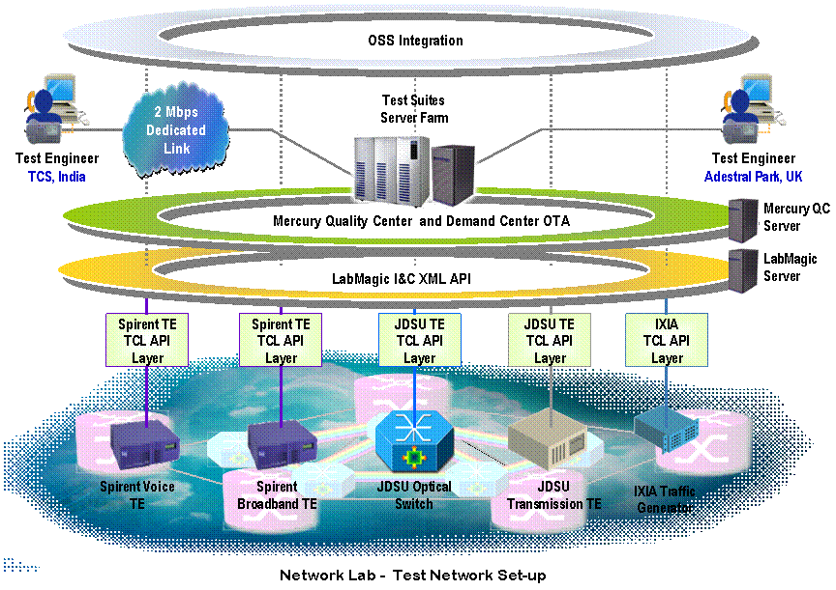
Network Test Factory
Responsible for developing the test cases and scripts for the Network integration testing for the 21 C Network elements
A factory approach
Facilitating high volume test case generation
Responsible for putting together a solution framework to drive the automation of test scenarios. The broad areas of automation include
Test Management (Demand management, Risk management, Test automation )
Inventory and configuration management for the lab environment
Test equipments to simulate and carry out the testing and capture results
TCS, as the Systems integrator is leading a consortium that brings together the various aspects of the solution as detailed below:
Mercury Quality Center (Test management)
Lumenare’s Labmagic (Inventory & Configuration Management)
Spirent, Ixia, JDSU (Test Equipments)13

Slide 48
Case Study Leading Carrier’s Carrier of North America

Slide 49
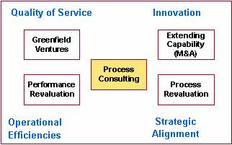
Process Consulting
Green Field - Definition & Deployment of Business and Operation Processes
Indian Convergent Service Provider
Assist in
Developing
Business
Strategy
Workshop for
Business
Process
Definition
Operation
process
Definition
Product
Selection
System Integration & Implementation
Business
Process
Re
Engineering
System
Architecture
Assessment
Fine Tune
Implementation
Business Process Synchronization : Acquisition
North American Carrier’s Carrier
AS- IS Process Study of Primary Company
Enhance with Best Practices
for TO-BE Process
Process Gap Analysis with
the acquired
company
Enhanced
NEWCO
process
System Gap Analysis
Enterprise
Architecture
Roadmap
Implementation Plan
Process and System Re-Engineering
North American Convergent Service Provider
Processes Replication
Processes
Re-Engineering
Processes Automation
Rolout & Fine Tune
Transitioned
Adapting to changes through process maturity & Responsive System
eTOM Process Maps
Best Practice based on Experiences
Adaptation to geography and service provider type
Proven methodology

Slide 50
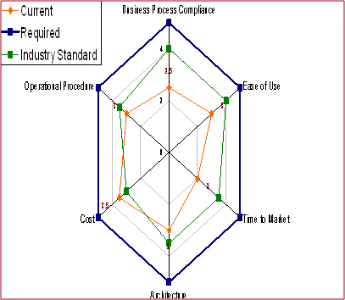
Leading Carrier’s Carrier - Acquisition
Carriers Carrier Service Provider
OSS System Profile
Statistics
Based in Canada
More than 1200 customers
Routes to more than 240 countries
Provides Voice and Data services
Aggressive Organic growth
Home grown systems
Strong Provisioning and Mediation system
Strong Rating & Billing Engine
Strong Revenue Assurance
Strong LCR
Users - 600 users
CDRs - 25 Million per Day
Rate Change
(SLA) - 4 hrs
Operational Challenges
Target ßco Vs OFIs
Applications overlaps/gaps in functional blocks in the OSS
Multiple systems (separate packages for rating, inter-carrier accounting etc.)
Multiple Databanks for same data across FAB channels
Middleware Solutions
Home grown solutions grafted on multiple new technologies
Lack of inter-operability/multiple stacks
OS and Databanks
Performance enhancements done at OS Level
Front-ends
Interconnections between Front-end applications
Thin Apps - lead to late error trapping
Standards limited to look-and-feel criteria, not on architecture
Literal implementation of Screen-by-Screen navigation of transaction/workflows

Slide 51
Leading Carrier’s Carrier - Business Consolidation
Business Process Synchronization - Acquisition
North American Carrier’s Carrier
AS IS Process Study of Primary Company
Enhance with Best Practices for TOBE Process
Process Gap Analysis with the acquired company
Enhanced NEWCO process
System Gap Analysis
Enterprise Architecture Roadmap
Implementation Plan

Slide 52
Leading Carrier’s Carrier Application Consolidation
Application Rationalization - Consolidation of 13 Applications
ICW
Capacity
Inventory
RERT
Site Code
Enterprise Workflow Management
Presales, Post Sales, Provisioning, Collection & Settlement
RERT
Site Code
MAPR
Pricer
REPC
Web Order
SECS
CustomerAccount
Creation
REPC
Order
Entry
VITRIA
REACT
Provisioning
Customer Management
Prospect, Customer, Account & Order
VITRIA
REACT
Provisioning
ICW
Capacity
Inventory
Prospect, Customer, Account & Order
ESTL
Pricer
NIMS
Inventory
NIMS
Inventory
Rating/Billing
GBS
Billing
PRICER
Pricer
Rating / Billing
Rates/ Contracts
CCMS
Contacts
GBS
Billing
Athena
Rate Master
Rates/
Contracts
SEAT
Inward
Traffic
Matching
REGP/
GCSC
SGRF
Billing
RETR
CDR Detail
REGP/
GCSC
SGRF
Rate Master
Oracle
Financials
AR/AP/GL
IPRM
IP Rating
Oracle
Financials
AR/AP/GL
SETS
TAX Module
Data Warehouse
Data Warehouse
SERM
Rate Master
A/R
Declaration
IPR
IP Rating
Collector
Collector
SEAT
Inward
Traffic
Matching
RETTG
Collector
Analysis Tools
Manual
Settlements
RECS
Collector
RETR
Mediator
RTDAS
RETTG
Collector
Analysis Tools
RETR
Mediator
RECI
Collector
NDAS
RECS
Collector
RTDAS
A/R
Declaration
IPCM
Collector
LCR
Traffic Info
RECI
Collector
NDAS
IPCM
Collector
LCR
Traffic Info
Proposed Return on Investment of 5 Million USD

Slide 53
Case Study US-based Convergent Services Provider

Slide 54
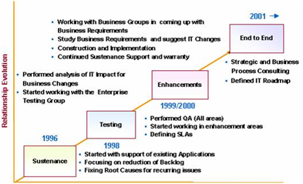
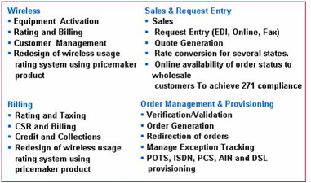
Large Convergent Service Provider
About Customer
Relationship Growth
TCS client is a both local, long distance and broadband service provider
TCS current share of customer total IT spend - 21%
Relationship commenced in 1996 with TCS proposing to client a vision encompassing
Roadmap to systematically take costs out of the operation
Change in IT strategy from in-house sustenance to
SLA-based TCS ownership
TCS responsibility for
In-Region Billing
Out of Region Billing
Order Management
DSL Workflow
Wireless Activation and Rating
Independent Testing and Verification
Relationship Growth
TCS has evolved as a strategic partner, and has more continuity to client IT than even client management

Slide 55
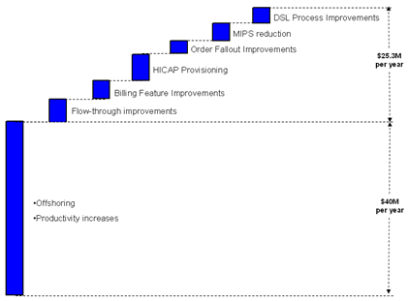
Cost Management
Annualized labor cost saving from 1996 base - $41 million
System and Process efficiencies can push out the envelope on total costs savings
Year | Customer Cost | TCS Cost | Total Cost
1996 | 104.4 | 0 | 104.4
1997 | 81.2 | 18 | 99.2
1998 | 46.4 | 35.5 | 81.9
1999 | 34.8 | 37 | 71.8
2000 | 23.2 | 40 | 63.2
2001 | 11.6 | 42 | 53.6
2002 | 8.7 | 41 | 49.7
2003 | 5.8 | 38.5 | 44.3
2004 | 5.8 | 35 | 40.8
> 60% savings
Labor arbitrage yields a base platform for cost savings. TCS can build on this base 10 - 20% YoY by focusing on enhancing application and process efficiencies and lowering process cycle times.

Slide 56
Optimizing Offshore Leverage is Key to lowering Labor Costs
Focus Areas
Transition
Customizing Process
Governance Model
Productivity Increase
Focus Areas
Re-engineering Billing – 4P platform
FCC Regulation
Off-shoring
Focus Areas
Business Process Outsourcing
Operational Efficiency
Focus Areas
Full ownership
Process Optimization
Infrastructure Optimization
ODC Level
Initiatives
Flow Through Improvement–
5 Million USD
Billing
Production
Support
Improvement-
4 Million USD
Business
Process
HiCap
Provisioning-
6 Million USD
per annum
Fallout
Improvements
(All Services)-
2.8 Million USD
System
Performance
Improvements
MIPS-
4 Million USD
DSL Process Improvement-
3.5 Million USD
Million USD
Savings due to off-shoring and productivity increase
TCS Value Adds (Only Cost Savings) - 40 Million USD
Total Savings - 300 Million USD

Slide 57
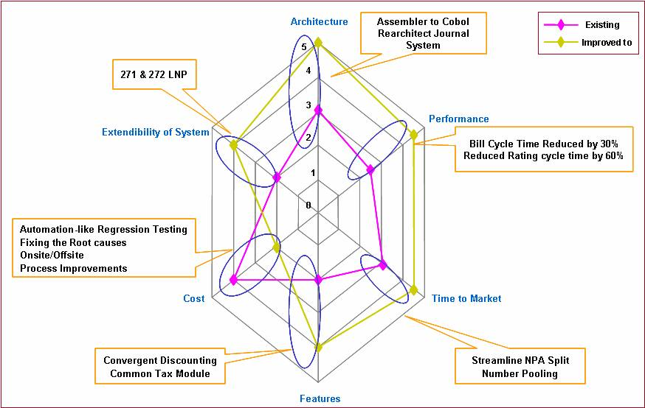
Application Improvements
Vanilla Offshore Leverage
Offshore Transitioning & 1-to-1 FTE mapping
Immediate savings of 30%
Every dimension of the billing system has been systematically addressed and improved
Productivity Enhancements
Resource consolidation of 2:1
100% reduction in resource cost
Notional savings of $3.1M through automation & re-engineering
Performance Enhancements
Process cycle time reduction
Business Feature enhancements
Notional savings of $3.8M
TCS has reduced overall bill cycle time by 30%. Consolidated cost savings for this system are $6.9M per year today

Slide 58
Case Study Leading Telecom Services provider in Kingdom of Saudi Arabia

Slide 59
Relationship Overview
The relationship has started in June 2006
The project kicked-off with a Large Systems Integration project which covered implementation of Billing and Customer Care functions in a new architecture and integrated environment. TCS is the sole system integrator with Convergys and Oracle Inc. as vendor partners to TCS.
Approximately 40 systems were integrated and 220+ transactions were developed to deliver the solution
This helped client to attain its vision of continuing to be the largest mobile network with customer-centric and profitable services and to nurture best in class customer service processes at the same time.

Slide 60
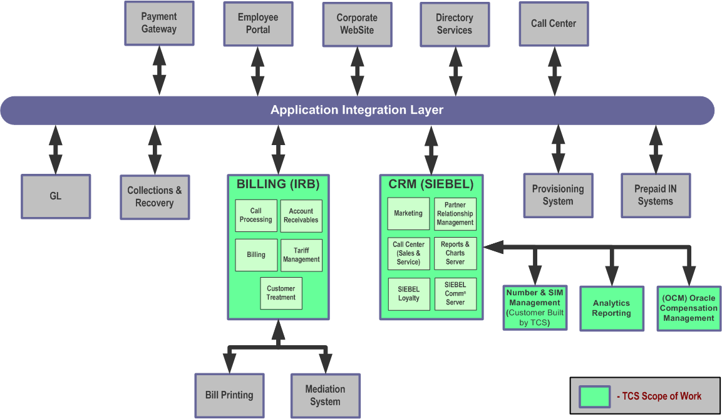
TCS Scope of Systems Integration
Legacy ICMS Product replaced with Siebel (for CRM) and IRB (for Billing)
Client benefits
Reduction in the IT spend by delivering a very cost-effective solution in lieu of a high cost 3rd party product license which would require additional customization for meeting the client’s business requirements
Reduction in the IT cost and overheads through a highly flexible, extendible, maintainable and scalable SOA based solution with little impact on future system upgrades and extendible to the land-line business operations with minimal customization.
Reduction in per-subscriber cost: An inventory management solution. as developed by TCS increases the utilization levels of numbers to the range of 75%-90% from an industry average of 50% there by boosting operational efficiency and reducing the per-subscriber cost.
Reduced resource and process overhead based on simplified and effective business processes. Speeds resource queries, minimize errors and reduce the overall cost of inventor

Slide 61
Implementation Timelines
Oct-06
Jan-07
Apr-07
Jul-07
Oct-07
Jan-08
Apr-08
Jul-08
Oct-08
Jan-09
Apr-09
Jul-09
Oct-09
Prepaid
Assessment
Design & Development
PAT
Pilot
Call-Center Deployment
Sales Cutover
12 Months of Testing/Validation
Postpaid
Assessment
Design & Development
PAT
Pilot
Cutover
18 Months of Testing/validation
Business Process Optimization
Architecture
Design, Development, Integration, Data Migration
Testing
User Adoption & Change Management
Deployment – Pilot, Rollout, Cutover
Large System Integration program full life-cycle activities successfully completed

Slide 62
Service Level Agreements Committed
In Operations & Maintenance phase, the following SLAs have been committed :
System Uptime
The target level for the availability is as given below.
First 2 months of operations: 98.6% (10 Hrs per month unplanned downtime)
2nd month to 6th month of operations: 99.3% (5 Hrs per month unplanned downtime)
7th month onwards: 99.95% (22 minutes per month unplanned downtime)
However TCS is fully committed and achieved 99.95 of uptime from the first 2 months of support period.
The first two weeks following the deployment and “go-live” of the solution would be considered a “Red-Hat” period where the teams would be focussing on stabilizing the system and ensuring that the performance is up to expectations. The SLAs would be applicable following this red-hat period.
System Response Time ( To be discussed and agreed)
System response time would be calculated as the duration between a transaction reaching the server and the response leaving the server . These response time values would be applicable only to user-impacting real-time transactions and not for batch transactions and other less critical transactions. A separate set of response time values would be established for these transactions as and when required

Slide 63
Assets and Frameworks

Slide 64
Telecom Assets & Frameworks
Software
Frameworks
Templates
Number Management System
SIM Management System
Commission Management (ICOMS)
Manage Billing Customer Account
Manage Product Offering
Manage Product Price
Manage CRM Customers
EVD - Electronic Voucher Distribution
ASAP Cartridges
Billing Migration Kit-Kenan
PPM - Product Portfolio Management
OPAL
ePOS
Electronic Voucher Distribution
Predictive Churn Mgmt + Communication Campaign Mgmt + Loyalty Mgmt
Customer Relationship Management
Number Inventory Mgmt
IN Monitoring Tool
Commission Management
eBRS
Operations Dashboard
CDR retrieval tool
Field Inventory Tracking
BPM Framework
SMS Proxy
Billing System Migration Pack (to Kenan)
Retail Management System
Service Enablement for Intelligent Network
iChoose
SoA for Telecom – SoFT TM
Business Enabling Architecture for Telcos – BEAT TM
Assessment Methodology – BETACO TM
Service Oriented Logical Architecture Reference – SOLAR TM
BI Domain Solution – BIDS TM
Telecom BI Domain Solution – tBIDS TM
TCS Integration Methodology for Enterprise – TIME TM
Integrated Methodology for developing Process-oriented Architecture using Component Technology – IMPACT TM
cFOCUS TM
Integrated Customer Data management – ICDM TM
Portal and Content Management for Enterprise - PACE TM
Telecom Customer Intelligence – TCI TM
Service Oriented Business Engineering Team – SOBET TM
Packet Information Multimedia Response - PIM2R TM
Customer Experience Framework (TEEM™)
SI Estimation template
BPR Plan for Process Assessment
SI Project plan template
Status reporting template
Billing Estimation Template
Gap analysis template
As is Business process maps from domains
Billing Requirements collection questionnaire
Requirements collection questionnaire template
Business process documentation template
Business Requirements documentation template
Questionnaire from domains
Product Evaluation Criteria
KPI Documentation
Solution Architecture template
Interface Design template
Detail Design template
Data mapping template
Capacity planning template
Migration Strategy template
Cutover Plan template
Installation Design template
Test Strategy - Siebel
Operations Manual template
Test Strategy - Billing
Deliverables across phases
BCP and DR

Slide 65

Communication and Network Solution - Frameworks
Value-Addition through Proactive Solutions to
Increase your product’s competitiveness
Technology change management
Reduce total time to market
2006 - 07
INCA
Packet N/W Test Gen
2005- 06
UMTS R&D Test Wizard
Automatic Script Generator
2004- 05
VoIP Solution Framework
SIP, RTP, RTCP
2003- 04
1xEvDV Reference Stack
TTCN - SDL Co-Simulation for Testing TTCN ATS
2002- 03
Mobile-IP Solution for Wireless System Simulators
SmarTEST: Automated Test Management Tool
ultraNAS, ultraGMM, ultraSM (UMTS and GPRS Stacks)
2001- 02
MOSAIC: Abstraction platform for various RTOS
VoIP Reference Stack

Slide 66
Our Commitment to Asset Creation
Applications
Processes
Tools
Research
CSG Kenan
Microsoft CSF
Infranet
Intec
TCS components
Oracle CRM
Metasolv
HP TeMIP, Micromuse Netcool
Vallent Metrica
Convergys
Models (e.g. eTOM)
Verticals such as wireline, wireless, IP, Broadband
Methodologies
IBM’s Web Sphere
TIBCO’s Active Enterprise
BEA’s Web Logic
Vitria
Study of emerging trends in telecom business
Impact study on telecom business with new technologies
Standards & guidelines
Innovations,
Assets, Tools,
Development Center
The Result
BETACOTM Model
BEATTM - “Best in Class”
BIFTTM
Revenue Assurance Framework
Implementation Accelerators
Deployable Process Maps
Readymade Tools
Mobility Solutions

Slide 67
TCS Architecture Roadmap Definition Approach
Business Vision and Goal
Understand Business
Goals & Plans
Business Road Map
Business Priorities
Business Transaction
Stakeholder & GAP Analysis
Business Process Map Swimline Diagram
Re-prioritize Business Needs
Business Process Description Document
Understand Business Process & Re-align it
IT Architecture Road Map - Operational, Tactical & Strategic
User Specification
System Specification
Integration Specification
Individual Programs
Product Selection
Steering Committee/IT Governance Board Review
Re-align Architecture & Re-define IT Roadmap
At each stage inputs are taken from various sources and frameworks to ensure best in class architecture and to ensure that all business requirements are being met
TCS has experience with evaluating, designing, re-engineering end-to-end system architectures or any specific component of it

Slide 68
TCS Business Transformation Framework -BETACOTM
Level of compliance to defined processes
Flexibility of implementation
Future considerations
Single data entry point
Information in the required format
Easy Navigation
Aid control of manual processes
TCS’s BETACOTM framework is a consulting tool used for evaluation purposes such as Architecture Analysis and product selection in conjunction with the Product Capability Matrix.
Job Control
Application Production Environment
Release Management
Configuration Management
Testing Procedures
Configurable
Customizable
Strategic Functionality
Extensible
Scalable
Robustness
Performance
Use of tools and technology
Enhancement cost
Support cost

Slide 69
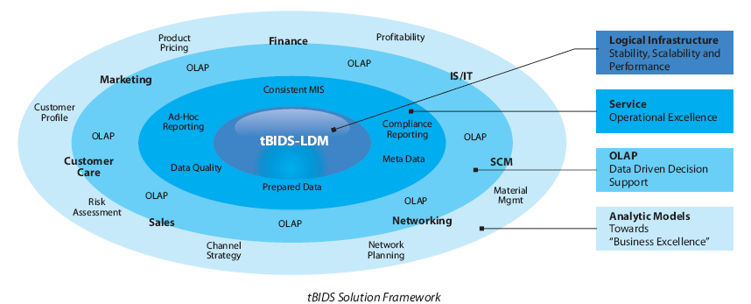
Business Intelligence Framework for Telcos - tBIDSTM
What does it offer to the customers?
Focused on addressing point solutions for telecom domain
A well defined methodology for domain specific solutions
Data Model for Domain solutions- Based on tBIDS
Key performance indicators for the solution areas
Templates for analytics and reporting
Prototypes for visual experience for our customers

Slide 70
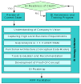
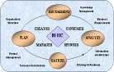
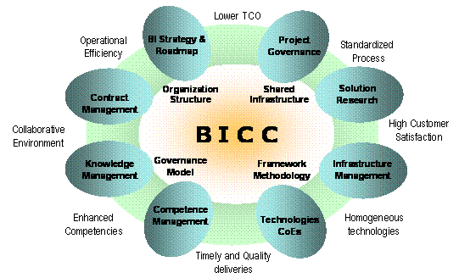
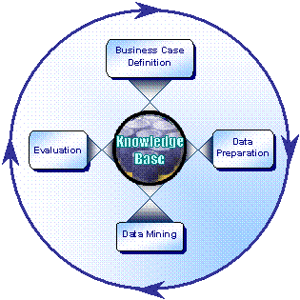
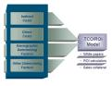
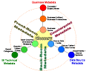
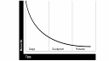
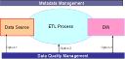
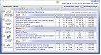


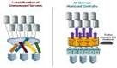
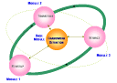
Business Intelligence Framework for Telcos - tBIDSTM
BIBP
BIHC
BICC
KDD
BCM
Metadata Management
Performance Management
Data Quality Management
Dashboard Management
Multi-site Rollout
Due-diligence
Data Marts Consolidation
Maintenance
Migration
Application
Data
M2X
Upgrade
TCS’s tBIDSTM solution for the Telecom Industry is a collection of Best Practices, Process Frameworks, Tools and Solutions
Methodologies that addresses
Strategy Definition: Migration, Data Migration (including Data Cleansing), Application/Tools Migration, Software Upgrade
Metadata Management
Maintenance
Performance Tuning
Data Mining

Slide 71
ROBossTTM
OSS Evolve TM
OSS Integrate TM
Requirement study & RFP/URS preparation
Assessment of existing OSS infrastructure
Models (such a eTOM)
Verticals such as wireline, wireless, IP, Broadband
Methodologies
OSS Enhance TM
Victory TM
Maintenance & Enhancements of existing OSS infrastructure
Offshore development centers
TCS Products
OSS Lab
Tailor made processes

Slide 72
TCS System Integration Methodology - OSSEvolveTM
Planning Process
Process Model/Mapping
Workflow Definition
Information Model
Fit
Analysis
Data
Model
Project Charter Refined
Actions
Business Mapping
Process Mapping
Validation
Finalisation
Deliverables
Business Map
Process Maps
Actions
Workflow
Definition
Validation
Finalisation
Sign off
Deliverables
Workflows
Actions
Define
Components
Priorities
interfaces
Validate
Sign off
Deliverables
Information Model
Actions
Define activities
Fit packages to activities
Identify Gaps
Define action plans
Deliverables
Gap Document
Action Plans
Actions
Define dataflows
Qualify dataflows
Define strategies
Deliverables
Data Model
Data flow strategies
Actions
Define
Priorities
Action plans
Responsibilities
Dependencies
Timelines
Deliverables
Project Charter
Implementation Process
Go Live
Define Configuration Parameters
Create Prototype
Refine Prototype
Preparing for GoLive
Actions
Questionnaires
User inputs
Deliverables
Questionnaires
Actions
Create Technical
Design
Create Master
Records
Configure
Deliverables
Demo Prototype
Actions
Obtain user inputs/feedback
Modify Settings
Prepare sample documents
Deliverables
Sample
Documents,
Reports
Actions
Unit Test modules, appl. Systems
Integration testing
User Training
Dry runs
Deliverables
System demo’s
User Training
Time tested methodology
Wide range of product vendor alliances
Domain knowledge depth from large engagements
Flexible and cost effective delivery models
Resource pool of product specialists
Add in solution packages to complement core products functionality
TCS brand process and quality orientation in delivery

Slide 73
Victory iRASTM
Home Location Register (HLR)
Provisioning
Provisioning System
Provisioning
Interconnect Billing System
Mobile Switching Center (MSC)
Usage Files
Usage
Files
Test Calls
Post Paid Billing System
Mediation Call Collection System
Usage Files
Customer
Profile
Roaming Usage
Records
Revenue Assurance System
Order Management
Core
Components
Interface
Components
Meta Data
Usage File Data
Pre Paid Billing System
Roaming Usage Records
Mobile Account Clearing House
(MACH)

Slide 74
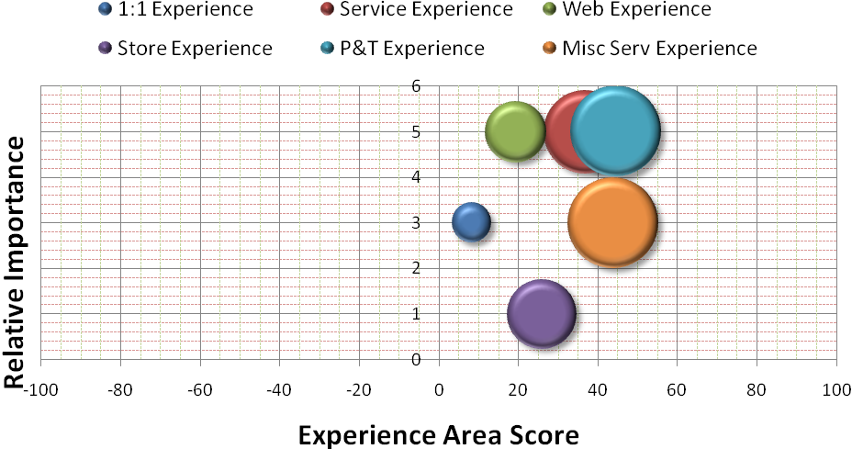
Customer Experience Framework (TEEM™) Consulting Framework
The customers’ impression of how the CSP communicates directly with each customer for marketing, general communication and problem solving
The customers’ impression of various 3rd party apps, services, roaming and customer care
The customers’ impression of the company’s products and services
The customers’ impression of billing, payment, acknowledgement etc. pre-paid & post-paid
The customers’ impression of the CSP’s web site, the content, usability and performance
The customers’ impression of the various point of sales (CSP Owned / Franchisee).

Slide 75
Analysts & Client Quotes

Slide 76

Quote from Analysts - Yankee Group
"Many of the world's leading telecommunications service providers have engaged TCS for its Global Delivery Model for IT and Engineering. TCS helps these companies address their business and technology challenges with regard to adoption of new wave technologies e.g. NGN, convergence, and triple play. TCS also helps service providers manage co-existence of legacy systems in a cost-effective manner and improve operational efficiency through off-shoring."
Declan Lonergan, Director Wireless Research EMEA, Yankee Group
"TCS is a leading source for the targeted deployment of skilled talent across a variety of disciplines."
Camille Mendler, Vice President, Telecoms Strategies International, Yankee Group
"Tata Group's cross-industry experience and global presence bring considerable credibility and financial
weight to its activities in the telecoms sector.“
Camille Mendler, Vice President, Telecoms Strategies International, Yankee Group

Slide 77


Quote from Analysts - PAC & Ovum
"TCS’ backing from the Tata Group (in particular the affiliations with VSNL and Tata Teleservices) combined with its global delivery capabilities and track record gives TCS a strong position to compete in both the UK and European telecoms markets."
Pete Foster, Associate Consultant, PAC
"TCS’ backing from the Tata Group (in particular the affiliations with VSNL and Tata Teleservices) combined with its global delivery capabilities and track record gives TCS a strong position to compete in both the UK and European telecoms markets."
Julia Reichhart, Consultant, PAC
"The growth of companies such as TCS and other off-shore players in the software development and services markets bring a fresh and positive aspect to the emerging ICT services industry. The work done to support many telco's development activities will now begin to move across into other verticals. Combine this with the other strengths in the Tata group, such as VSNL, and a very powerful Indian-based conglomerate in the IT services market emerges."
Chris Lewis , Enterprise Practice Leader, Ovum

Slide 78




What Our Clients Talk About TCS
“Testing is a critical aspect of the 21CN program, ensuring that BT and the telecom industry as a whole has full confidence in the performance of the completed network. In this capacity, TCS has shown that it has absolutely the right capabilities for the job.”
Randy Tucker, director of technology and testing, BT Wholesale Networks
“After much evaluation, we settled with TCS because they showed CTM that they were innovative, able to deliver quality, exhibited depth and breadth of skills and demonstrated thought leadership,”
“At CTM, we were planning an infrastructure to take us into the future and not just address today's needs. TCS provided that answer.”
Phil Green, CEO, CTM Macau
“TCS is a valued customer, supplier and strategic partner. TCS has maintained a focus on customer success and capturing market leadership through technology and innovation. I congratulate TCS on their tremendous global growth, and I look forward to our continued partnership in the future.”
John Chambers
Chairman & CEO, Cisco Systems, Inc.,
"I would like to thank TCS for the commitment to our company demonstrated during the upgrade of our core CRM system to Peoplesoft. It is fair to say that in all my years of being involved in IT I have not seen such a dedicated professional group of individuals as your employees. The project has been a tremendous success and TCS can take a good share of the credit for that..”
Michael Young
Director Technology & Services, H3GA

Slide 79




What Our Clients Talk About TCS
"TCS are a trusted business partner. They now manage key elements of our business on which everything else depends. The relationship has grown over the past 2 yrs and will continue to grow.TCS is very proactive about finding opportunities, where both sides can actually win out this relationship and make significant progress .”
David Cooper
CIO, TalkTalk Residential
- 79 -
“TATA Group, India, has carried out assesments on Malcolm Baldrige criteria for performance excellence on PT Telkom..I found TATA consultants to be highly professional in conducting these assesments. The assesors have added value to our journey towards performance excellence and I would therefore recommend their services for any other companies and wish them the best for all assesments on Baldrige.”
Kristiono
President Director/CEO, PT Telkom
"I would like to thank TCS for the commitment demonstrated during Projek Jambatan which we embarked on to streamline CELCOM PostPaid Billing Operations…The Project has been a tremendous success in terms of meeting the key objectives and has resulted in significant reduction in customer complaints and thus contributing to the positive customer satisfaction index.”
Karan Henrik Ponnadurai
Senior VP, Celcom
“TCS with respect to the work we already had done with them proved they have capability both in terms of technical competence as well as people, processes they have brought in the platforms as well.”
“We certainly seen the level of certainty improve release on release and we have very confidence to say as we move forward to 2011-12 that our confidence around the ability to deliver that certainty is going to improve so in my view absolutely! “ Kevin Adams
Head of Business Service Systems Development-IT, Cable and Wireless Worldwide

Slide 80
Thank you
Visit www.tcs.com\telecom or Email global.telecom@tcs.com

